Slide 1
Traffic Lights
Instructions and Wiring Diagrams

Slide 2
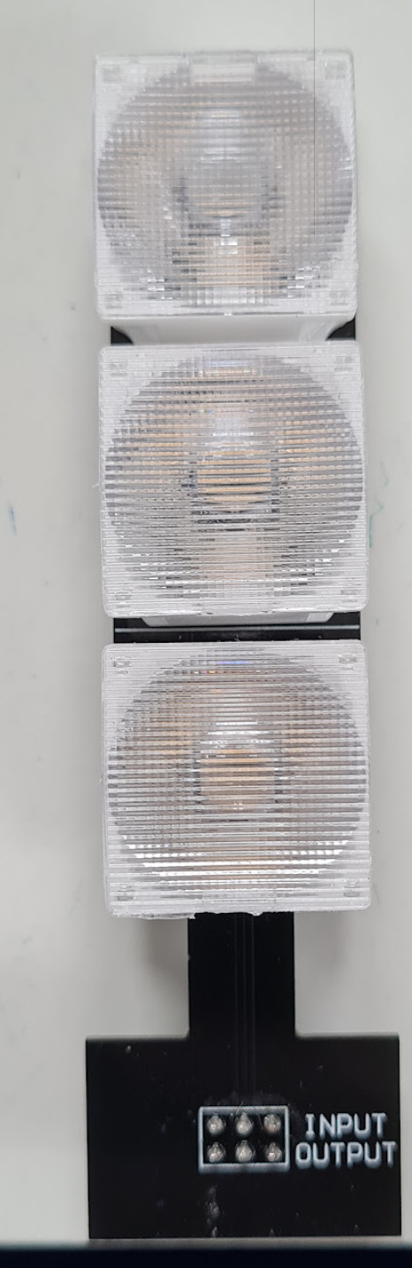
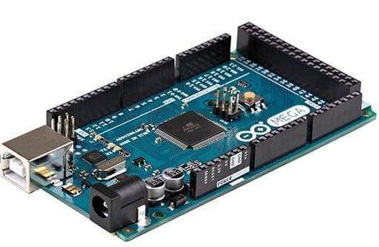
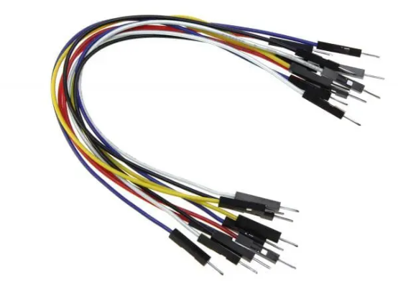
Requirements
Arduino (MEGA, Nano, etc.)
2 Traffic Lights (Assembled)
6 Wires male to male

Slide 3
Steps to follow
Assemble the Traffic lights as shown in the following diagrams.
Download the program to the Arduino Mega from GitHub.
Install the Required libraries for Arduino.
Flash the Arduino.
Make the appropriate connection according to the wiring diagrams.
Connect the Arduino to a power supply.
Verify if the traffic lights are working correctly.
Place the Traffic Lights in the correct position on the track.

Slide 4
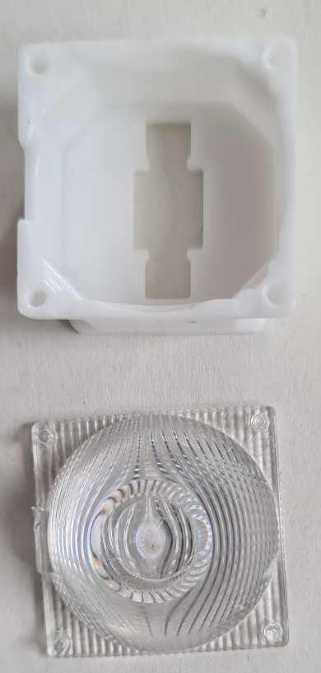
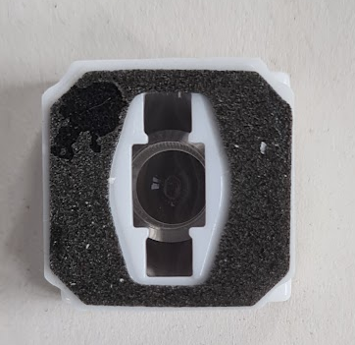
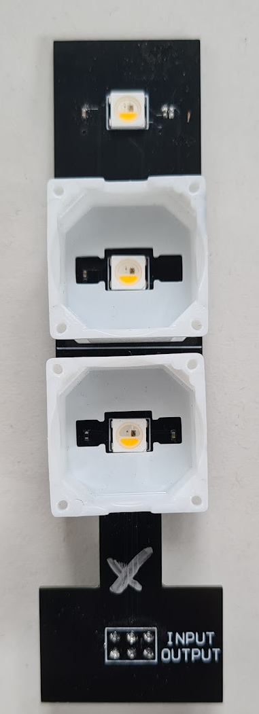
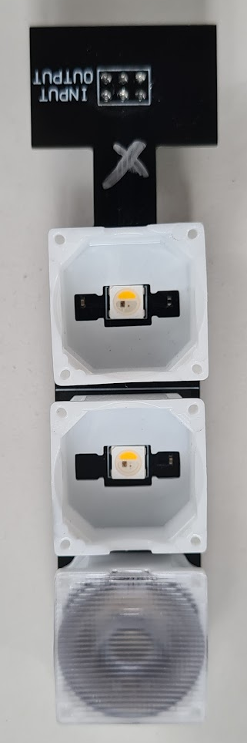
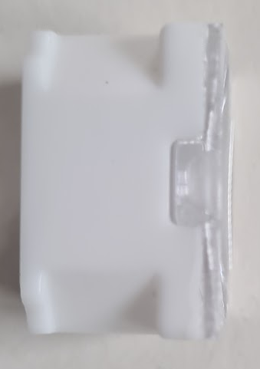
Traffic Light Assembly
Traffic light is composed of 2 parts
PCB (LEDS soldered)
Light Diffusers (Base and plastic diffusers)
The Light Diffusers come as a stick–on attachment.
Assembly Steps:
Remove the plastic diffuser (transparent) and peel off the stick base, as shown in Figure 1
Attach the plastic base (white) to the PCB, as shown in Figure 2
Attach the transparent diffuser to the base (be careful with the small plastic indentation) Figure 3
Assembly of the Traffic light as shown in the next slide
Figure 1: Light diffuser
Plastic indentation
Figure 2: Base attachment
Figure 3: Diffuser attachment

Slide 5

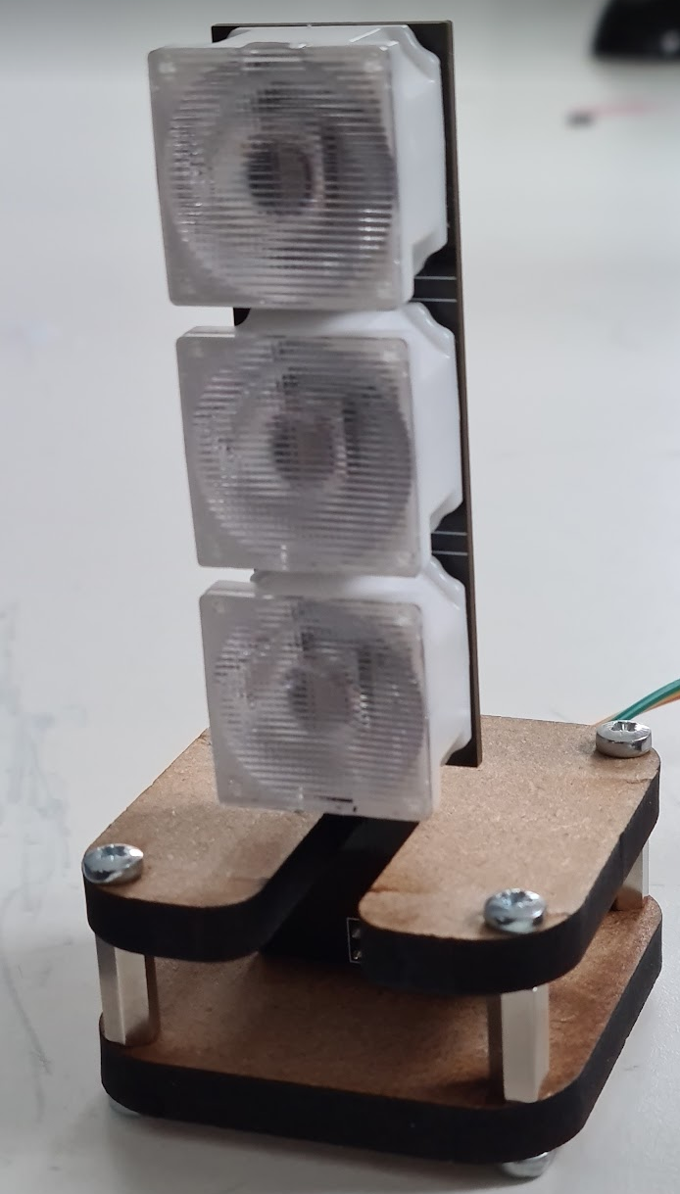

Slide 6
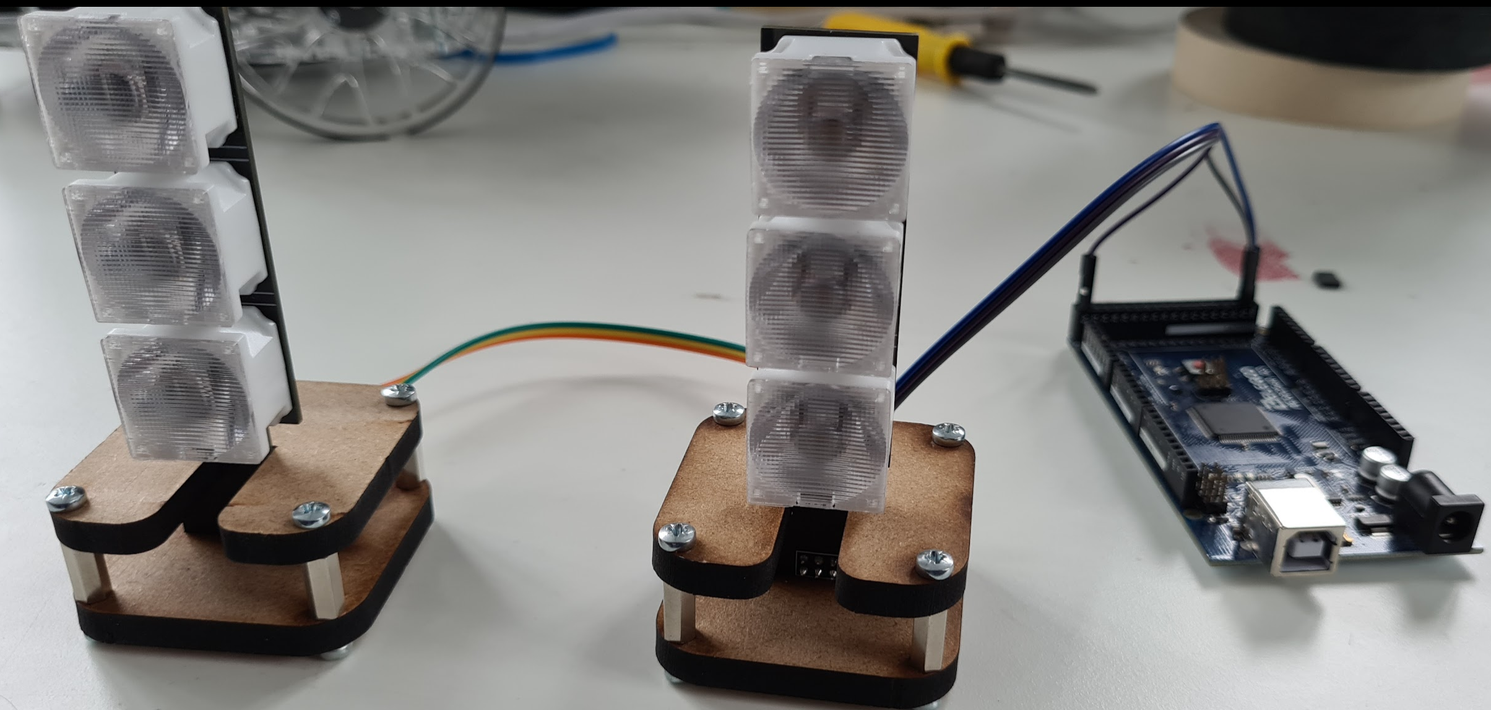
Connection Diagram (Example Arduino Mega)
The traffic light communication is done via a daisy chain protocol
…
Arduino
(MCU)
Traffic Light (1)
Traffic Light (2)
Traffic Light (3)
Traffic Light (n)
In
Out
In
Out
In
Out
In
Out

Slide 7
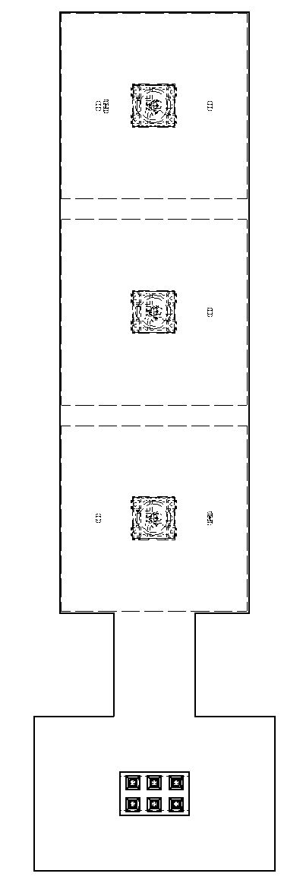
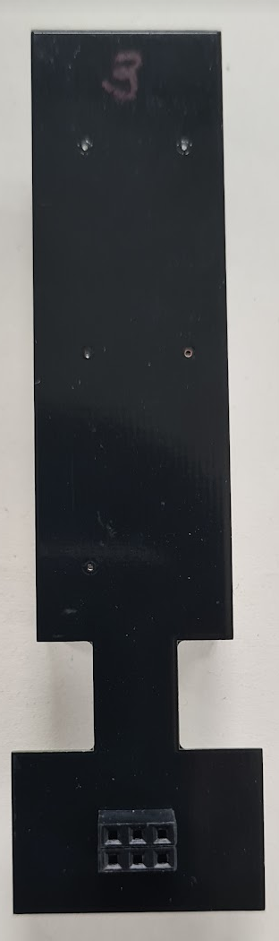
Connection Diagram (Example Arduino Mega)
The connections for the input and the output follow the servo motor standard (Figure 5)
The input and output of the daisy chain connection is shown in Figure 4.
SGN
+5V
GND
Figure 5: Connection Pins
Input
Output
Figure 4: Traffic Light Back View

Slide 8
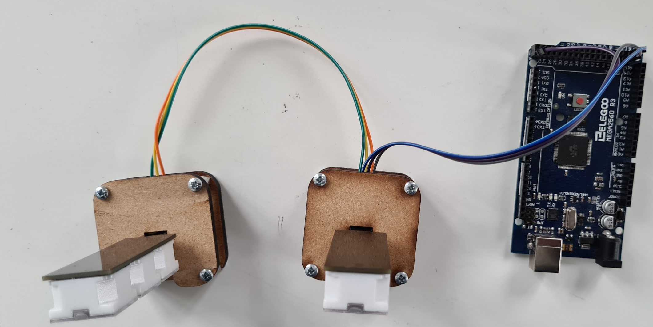
Connection Diagram (Example Arduino Mega)
Arduino Mega
(MCU)
The connection diagram using the Arduino Mega is shown in Figure 6.
By default, the Pin selected in the Arduino Mega for the SGN is pin 52.
Flash the Arduino (Next Slide)
The SGN Connection Pin for the Arduino can be changed in the file: nlights.ino (line 12)
Input
SGN
Output
Input
SGN
SGN
+5 V
Traffic Light (1)
+5 V
+5 V
Traffic Light (2)
I/O Pin (52)
GND
GND
GND
+5 V
GND
Figure 6: Connection Diagram
Figure 7: Connection with real Traffic Lights

Slide 9
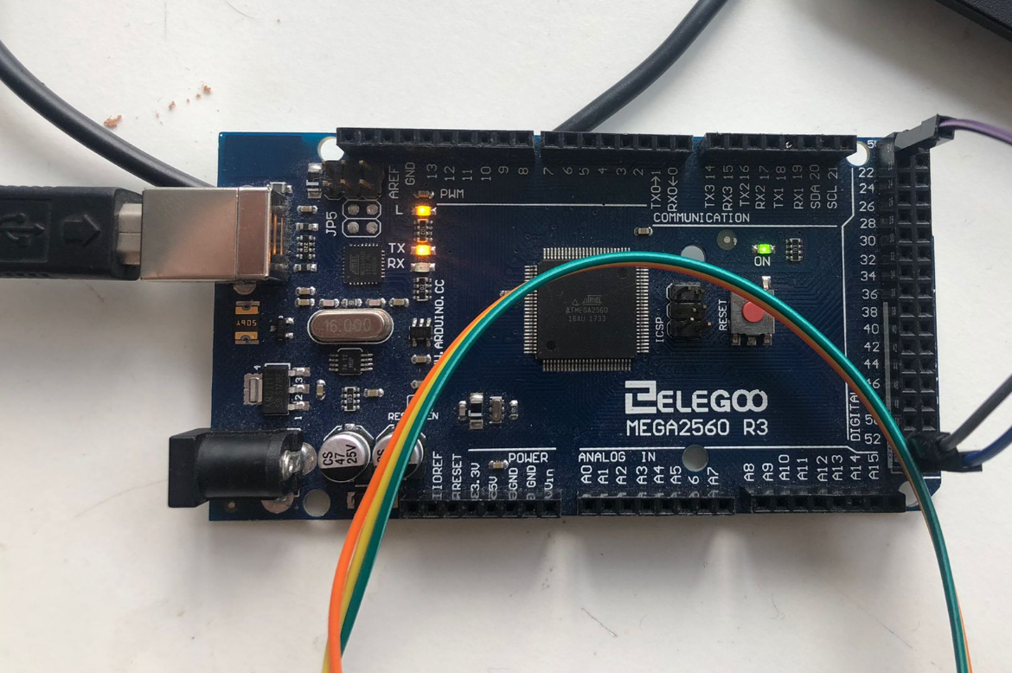
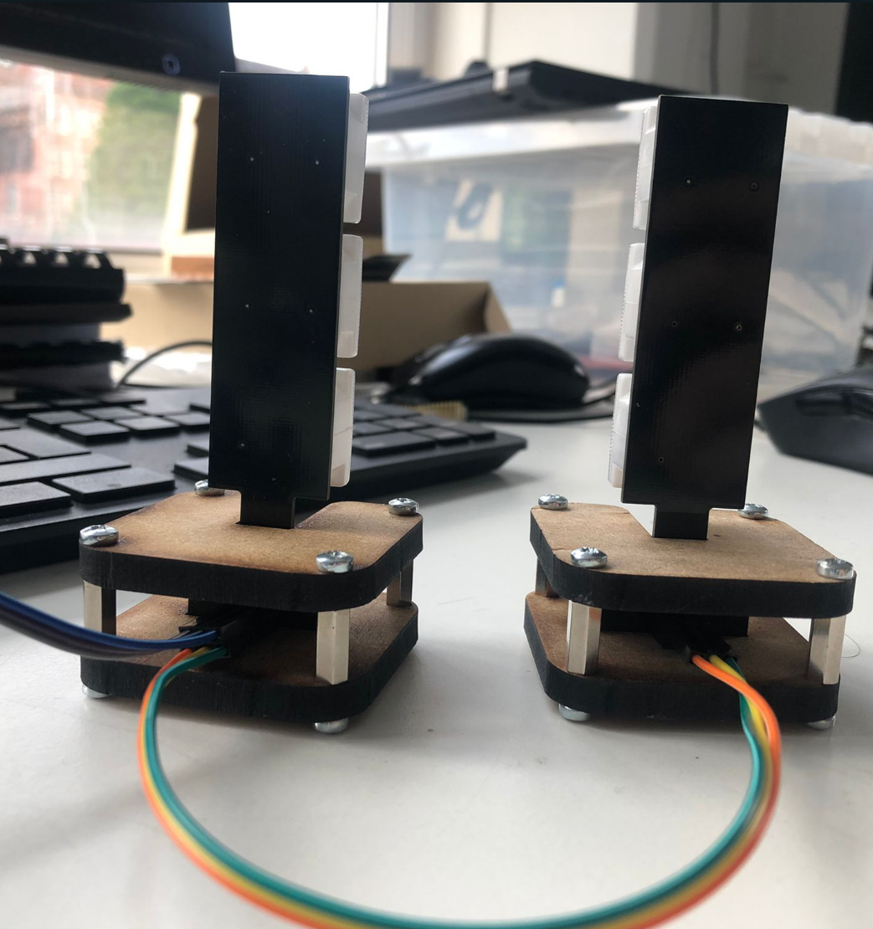
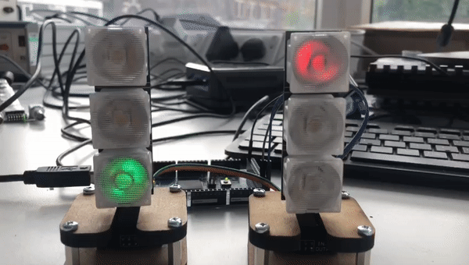
Flashing the Arduino
Connect the Arduino to the computer
Open the program: nlights.ino
Make sure the correct libraries are installed. (Next Slide)
Make the necessary changes (Pins, time, etc.).
The SGN Connection Pin for the Arduino can be changed in line 12.
Upload the program to the Arduino
Verify if the Traffic Lights are working

Slide 10
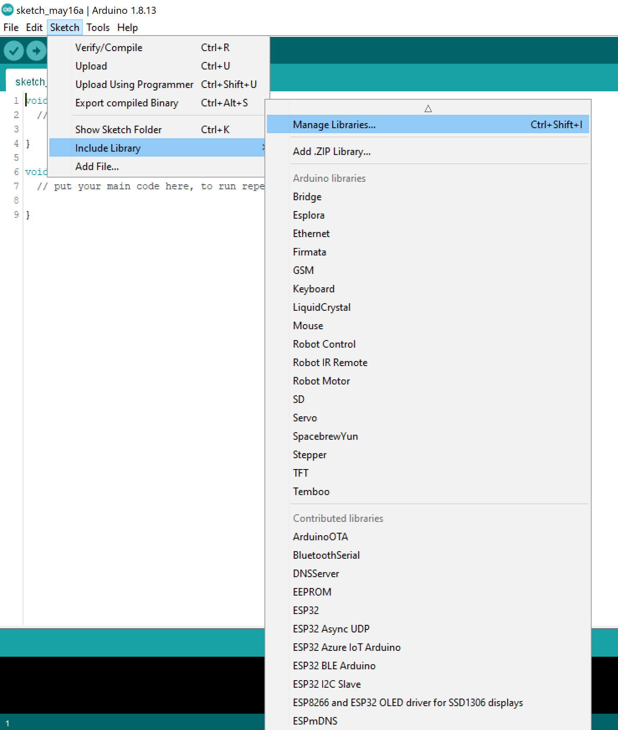
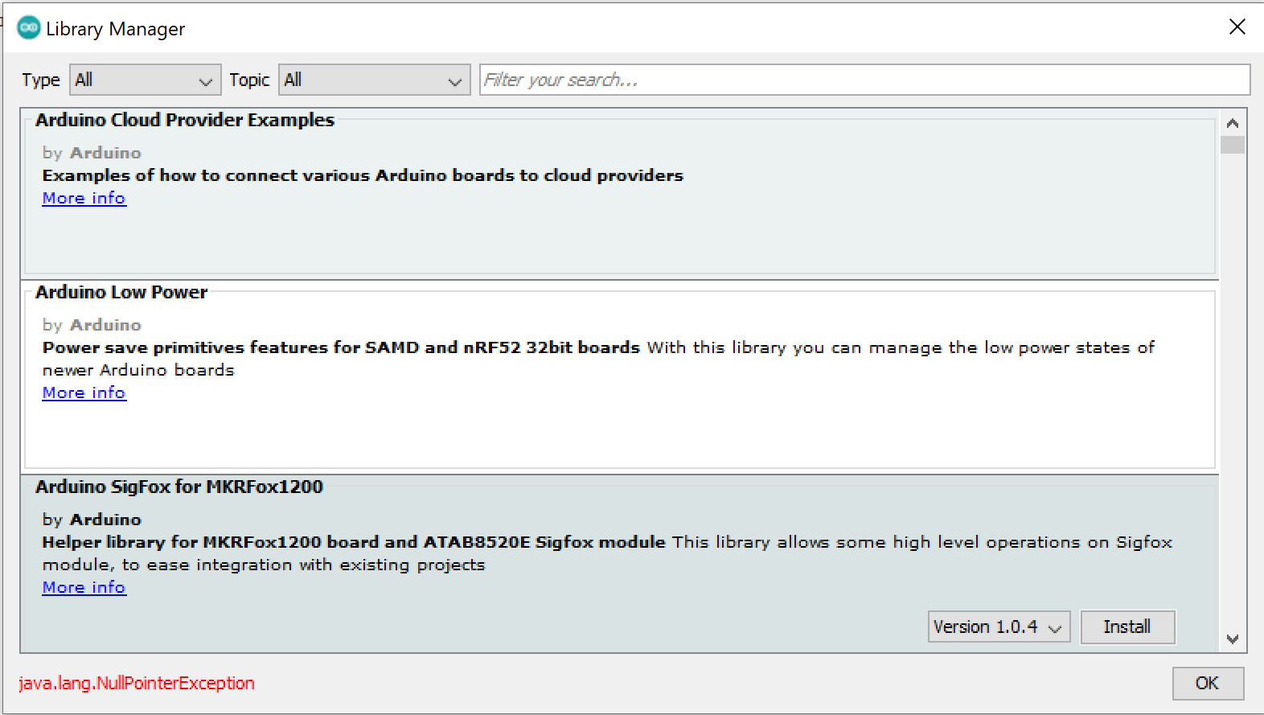
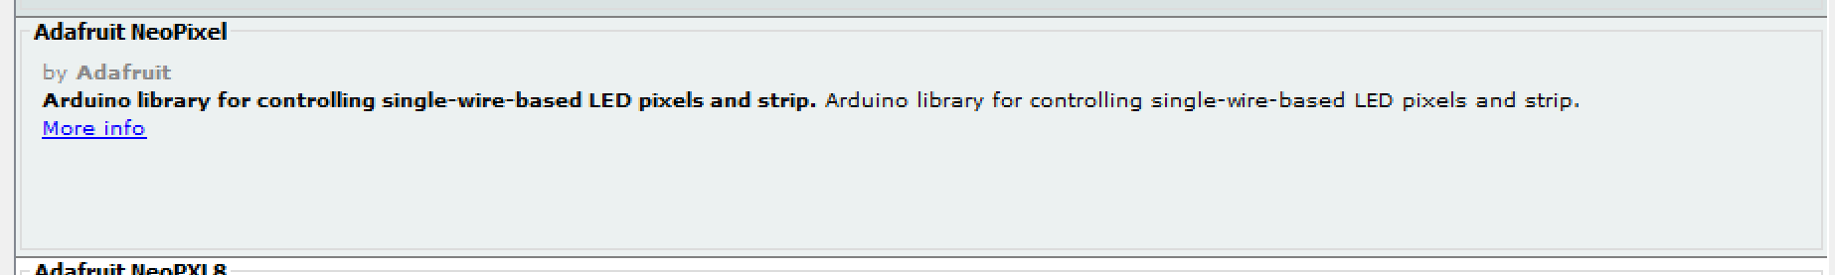
Arduino Libraries
To install an Arduino library, follow the next steps:
Go to Sketch >> Include Library >> Manage Libraries
A pop-up window will appear
Search and Install the following Libraries
Adafruit_NeoPixel.h
Restart the Arduino Environment
Library Manager
Library to be Installed

